Slide 1

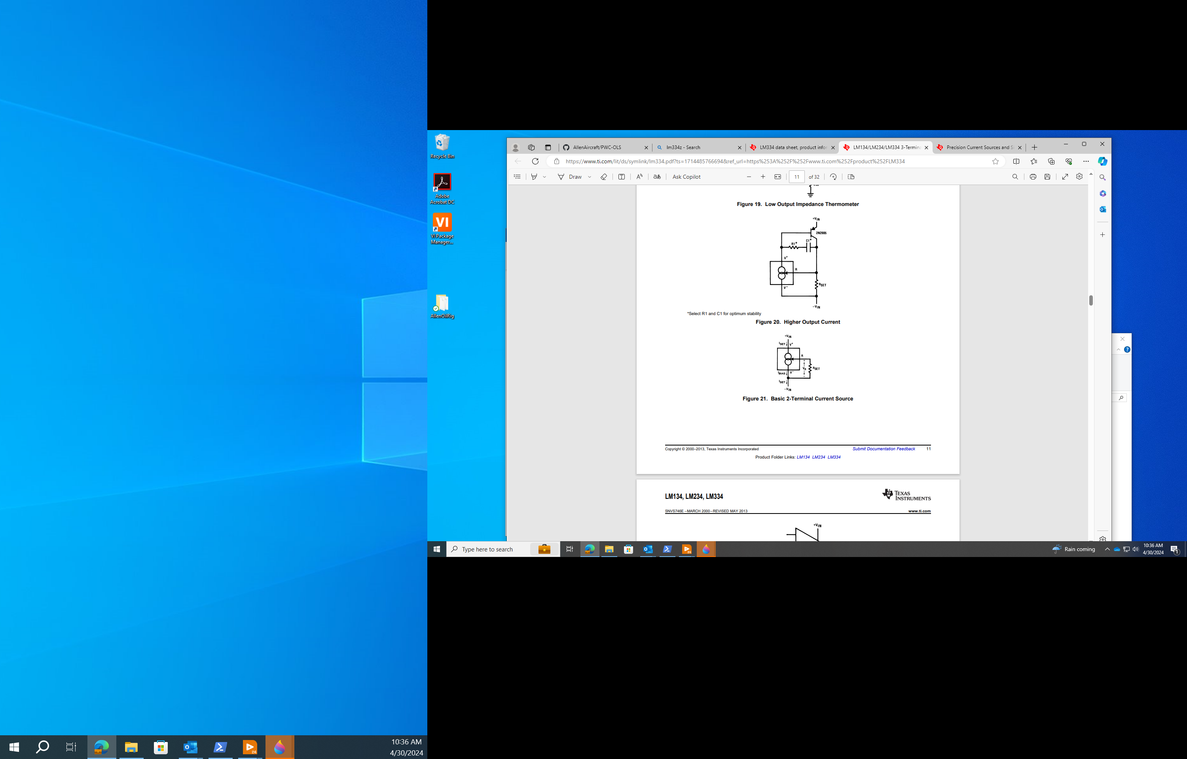


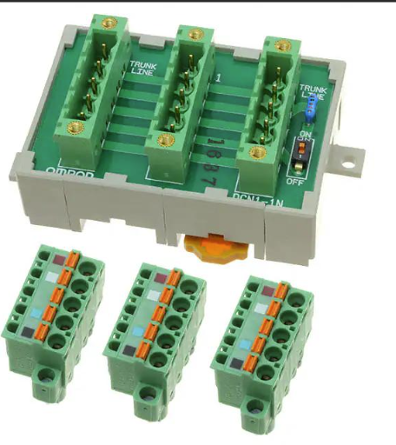
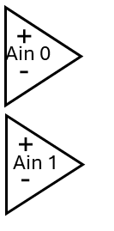

24Vdc
SMPS
24Vdc
Instrument
Power
Interface PCB
Custom Unit
Connector
TANK
To Laser
14ma
I-source
x8
Left
Right
Pump
4A DC Motor
Motor
Controller
Pololu
18V7
Buffer/
Scaler
x8
DUT
Sensor
x4
CONNECTOR EXAMPLE
USB Hub
Laser
=
Keyance
LK-G2000
LV Win11
Workstation
DataQ
DI-2108
NOT TO SCALE

Slide 2
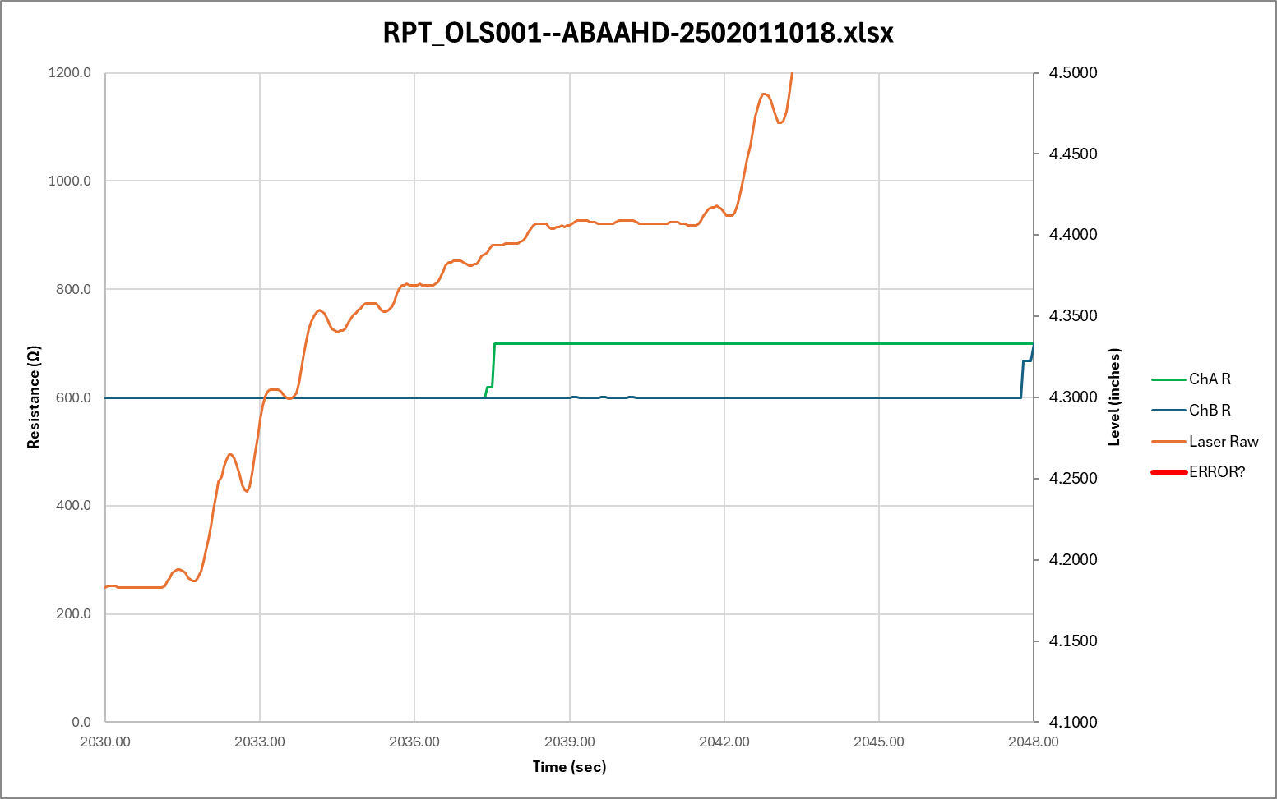
100%
30%
7%
Waiting

Slide 3
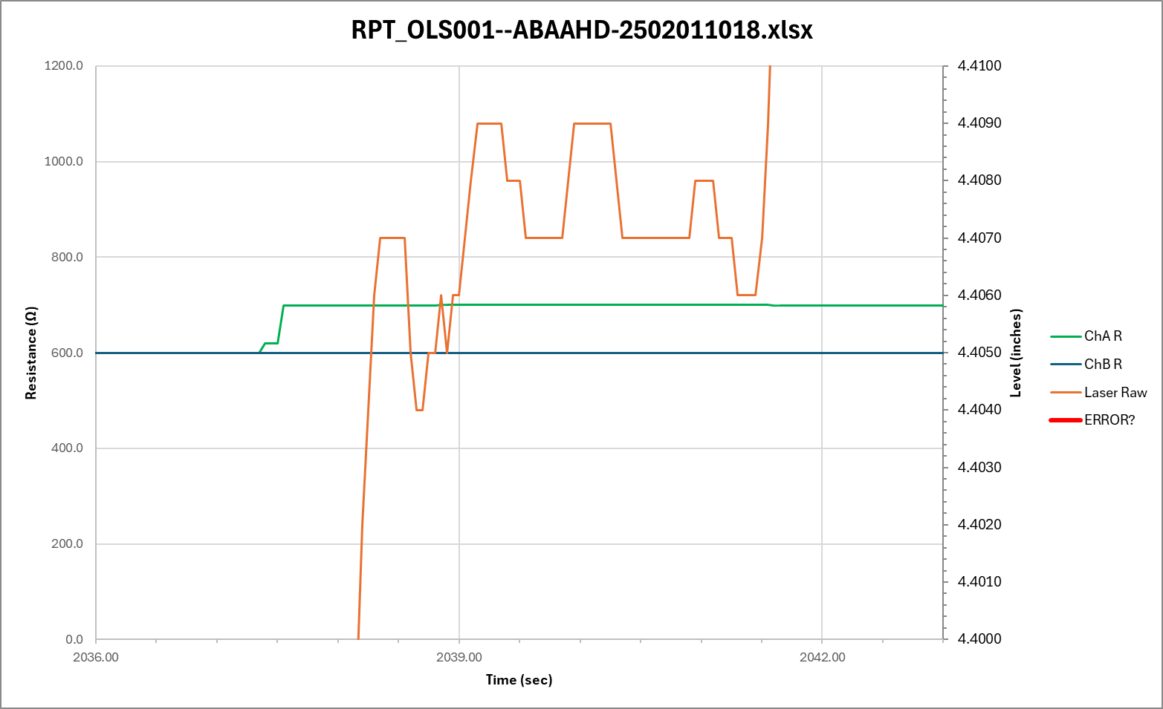

Slide 4
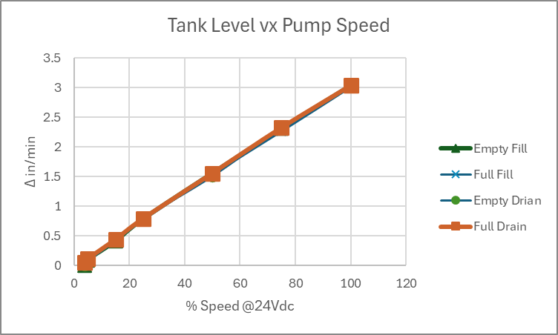
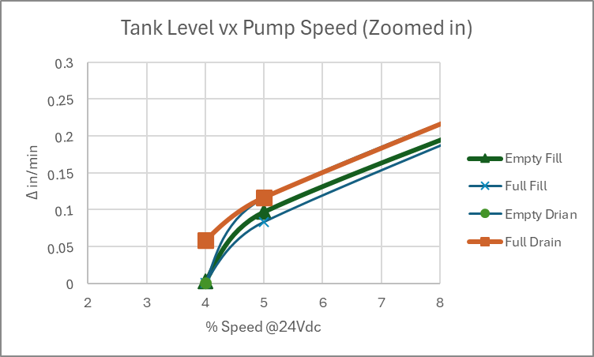
Tank Level Response
Using the Pololu MC18V7 PWM motor controller with Vs set to 24Vdc, The Δ Level was measure for 30 seconds at various percent of max speed (100% duty cycle) for both FILL and DRAIN at near EMPTY and near FULL.
The response has a minor shift at each case but is basically linear down to about 5% resulting in fill rate of about 0.1”/min where the control becomes unstable by 4% as shown in the ‘Zoomed In Plot.
Without doing an extensive fluid analysis, this response is assumed to be adequate for the MLOI application.
Data from mloi:\PM_Folder\_3 Develop\Design Calculations.xlsx sheet Tank. 3/4/2025 R. Ales

Slide 5
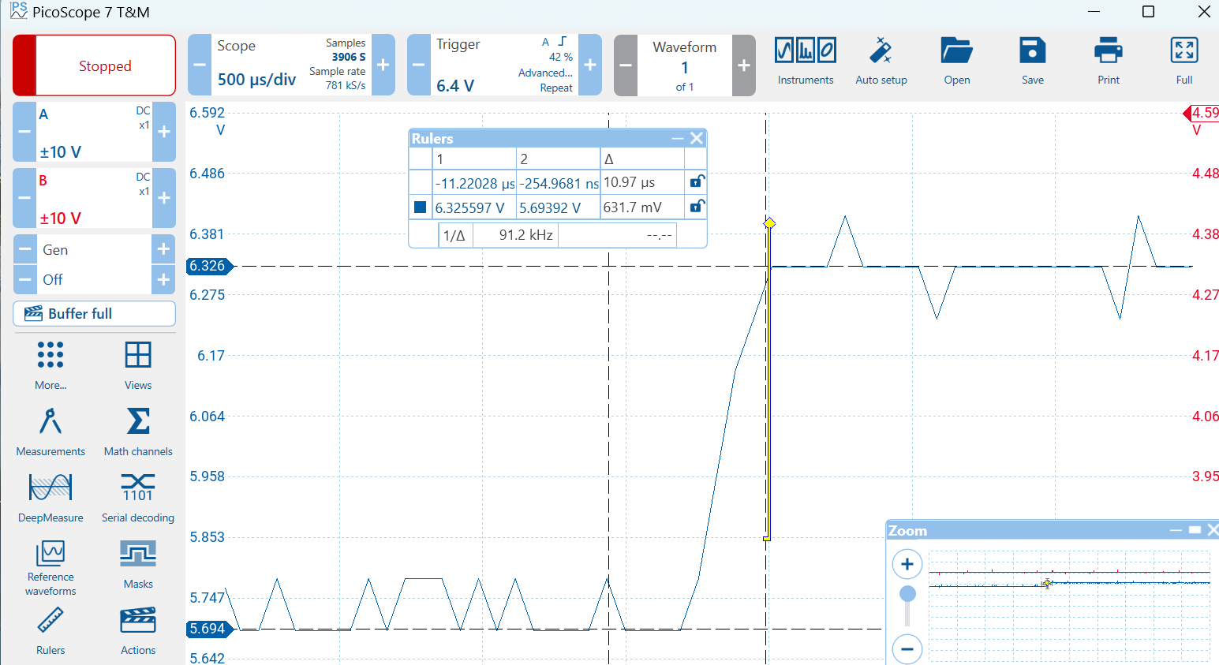

Slide 6
24Vdc
SMPS
24Vdc
Instrument
Power
Interface PCB
Custom Unit
Connector
Left
Right
Motor
Controller
Pololu
18V7
14ma
I-source
x8
Buffer/
Scaler
x8
Pump
4A DC Motor
+5Vdc
USB Hub
Laser
Keyance
LG-K
DUT
Sensor
x4
LV Win11
Workstation
DataQ
DI-2108

Slide 7
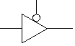
Tri-state
Buffer
Motor
Controller
x4
On/Off
Fwd/Rev
Left
Right
+5Vdc
Do-6
-
+
Ain 0
Do-5
-
+
Do-4
Ain 1
DUT
Sensor
x4
DataQ
DI-2108

